Slide 1
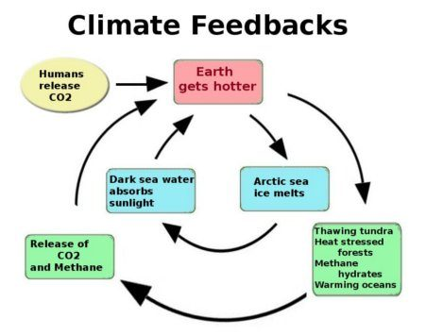
Amplifying feedback loops

Slide 2

Amplifying feedback loops
$$∆T=∆T_{GHG}$$

Slide 3


Amplifying feedback loops
$$∆T=∆T_{GHG}×(1+ f)$$
$+∆T_{GHG}$ $× f$
$f$ has to be less than 1 for this to converge

Slide 4

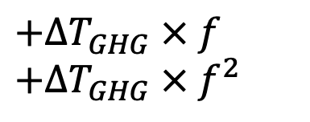
Amplifying feedback loops
$$∆T=∆T_{GHG}×(1+ f+f^{2})$$
$+∆T_{GHG}$ $× f$
$+∆T_{GHG}$ $× f^{2}$
$f$ has to be less than 1 for this to converge

Slide 5

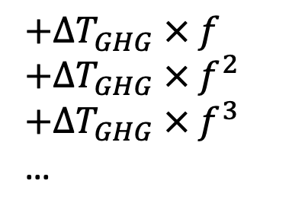
Amplifying feedback loops
$$∆T=∆T_{GHG}×(1+ f+f^{2}+f^{3}+…)$$
$+∆T_{GHG}$ $× f$
$+∆T_{GHG}$ $× f^{2}$
$+∆T_{GHG}$ $× f^{3}$
…
$f$ has to be less than 1 for this to converge

Slide 6
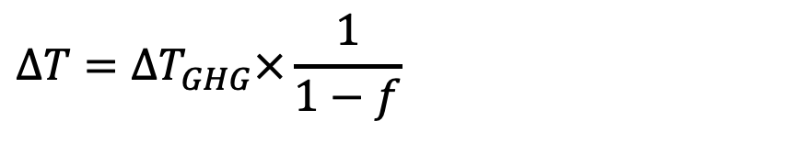
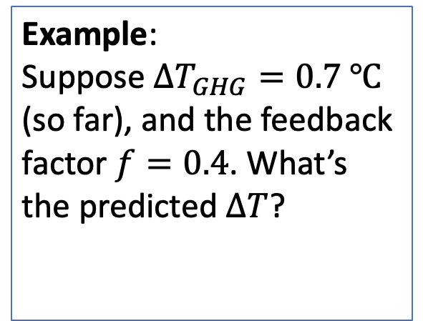
Amplifying feedback loops
$$∆T=∆T_{GHG}×\frac{1}{1−f}$$
$+∆T_{GHG}$ $× f$
$+∆T_{GHG}$ $× f^{2}$
$+∆T_{GHG}$ $× f^{3}$
…
Example:
Suppose $∆T_{GHG}=0.7 ℃$ (so far), and the feedback factor $f=0.4$. What’s the predicted $∆T$?
$f$ has to be less than 1 for this to converge

Slide 7

Amplifying feedback loops
$$∆T=∆T_{GHG}×\frac{1}{1−f}$$
$+∆T_{GHG}$ $× f$
$+∆T_{GHG}$ $× f^{2}$
$+∆T_{GHG}$ $× f^{3}$
…
Example:
Suppose $∆T_{GHG}=0.7 ℃$ (so far), and the feedback factor $f=0.4$. What’s the predicted $∆T$?
$∆T=1.2℃$
$f$ has to be less than 1 for this to converge

